Slide 1
Eli Chandler Sprint 004
May 24 – June 7
Work hard rating 3/5

Slide 2
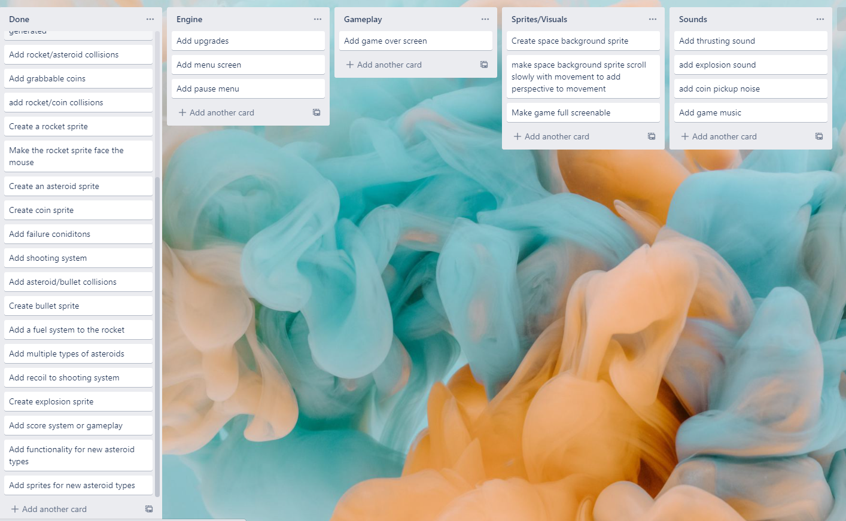
KANBAN Board at the start of the sprint

Slide 3
Sprint reflection and summary
The main achievement of this sprint was converting the game object to a view object. This will allow me to more quickly and properly develop a start menu, pause menu and game over screen. I think I could have accomplished more in terms of code during this sprint but the additional gameplay concepts will help flesh out the game quite a bit

Slide 4
Major changes and achievements
During this sprint I converted my game object to a view, this allows me to quickly switch between different views such as a pause menu, game over screen and the actual game itself
I also made the game Fullscreen able which makes the game look better because it fills up the whole screen instead of being a small window
I also added a new asteroid type ‘time asteroids’ this adds to the time before the rocket dies I am currently using a value of 5 seconds for testing
I also brain-stormed some more elements to the gameplay of the game, which I will talk about in the Notes for next time section.

Slide 5
Brief description of your testing
When I made the game full-screenable using F, there was an issue. The game is originally 1280x720 but the monitor is 1920x1080, so the resolution of the game changed when it was full screened. This is an issue because my screen dimensions are hard coded as 1280x720, so mouse movements are still based on this scale even when its full screened. I fixed this by changing the global screen dimension variables when the game is full screened or on full screened.
I tested my time asteroids by shooting them and looking at the timer, every time I shot them my time went up by 5 so I concluded they were working correctly.

Slide 6
Link to testing/results table
Test | Expected output | Actual output
Mouse at far right of screen resolution1280x720 windowed mode | 1280x720 | 1280x720
Mouse at far right of screen fullscreen mode | 1280x720 | 1920x1280
I thought that fullscreening would resize the monitor to fit the game, but it actually resizes the game to fit the monitor. I fixed this by changing the resolution values of the game so that mouse input is still correct when the game is fullscreened
Results after fix:
Test | Expected output | Actual output
Mouse at far right of screen resolution1280x720 windowed mode | 1280x720 | 1280x720
Mouse at far right of screen fullscreen mode | 1920x1080 | 1920x1280

Slide 7
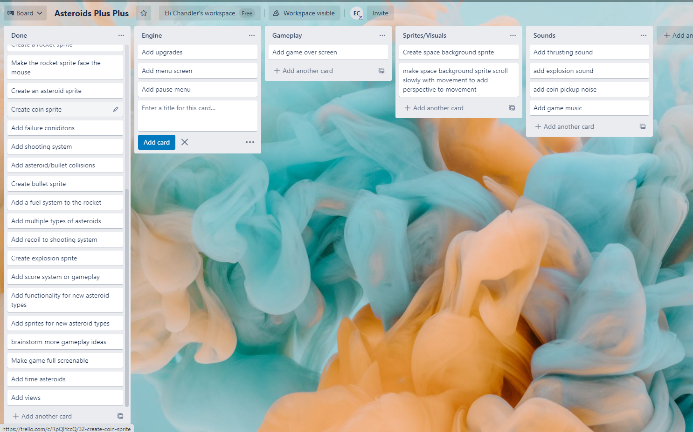
KANBAN Board at end of the sprint

Slide 8
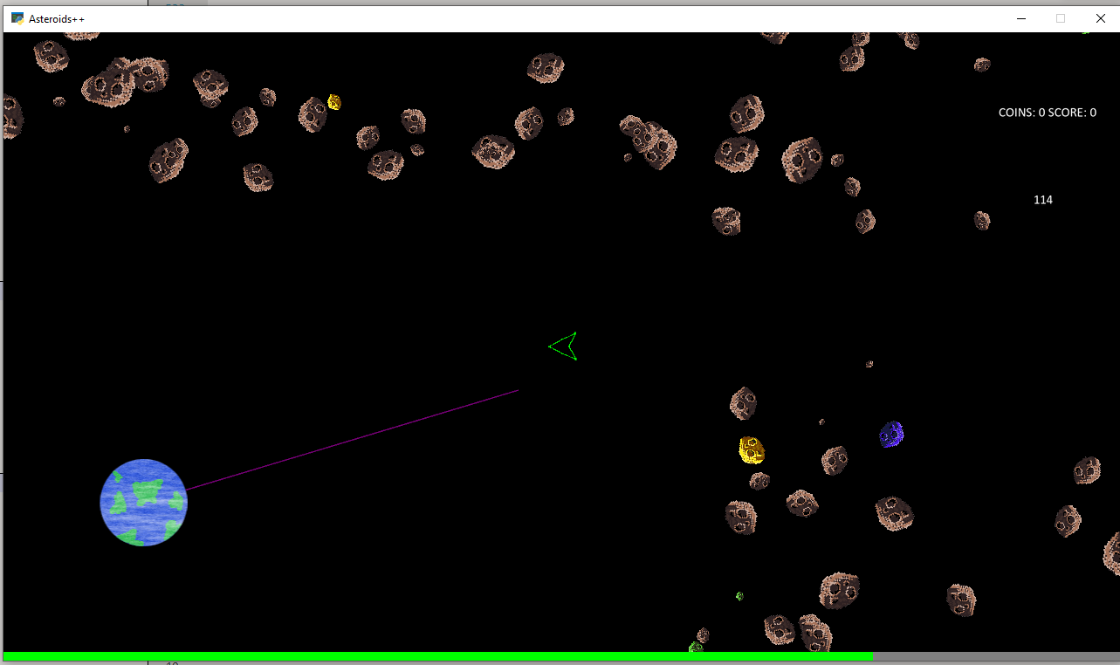
Screenshot of game at the end of the sprint

Slide 9
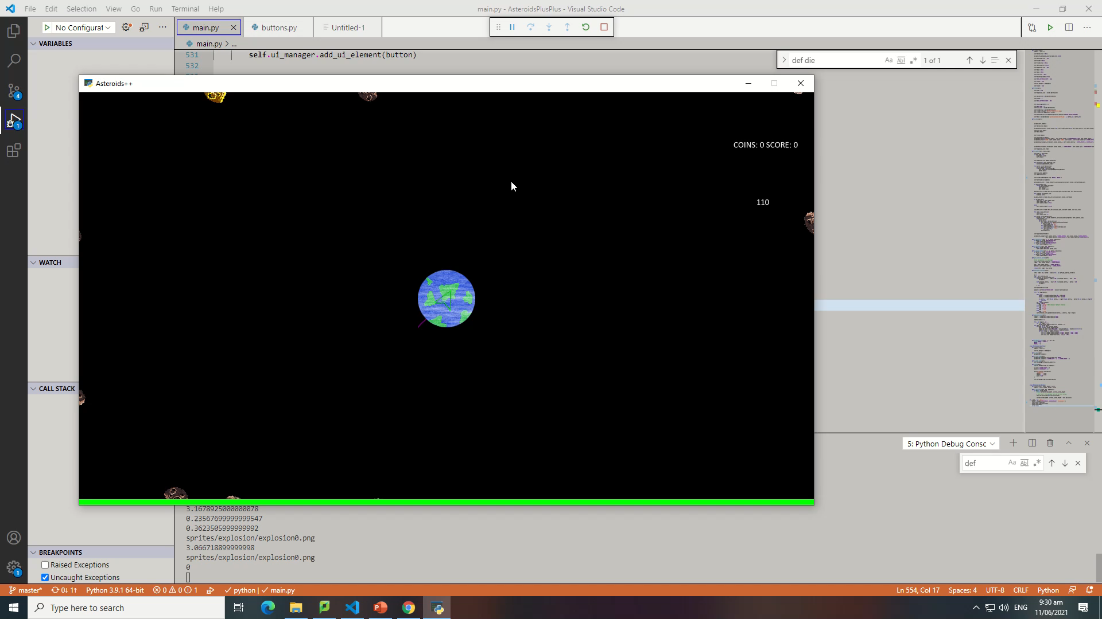
Video of the game at the end of the sprint
The PowerPoint screen recorder cannot record Fullscreen games, but when the game appears frozen in the video it is me switching to Fullscreen mode.

Slide 10
Notes for next time, future improvements
I brainstormed some new ideas for gameplay with somebody who tried the game. I liked some of the ideas they gave me and formed a concept through that:
Make it so the timer is your 'oxygen' you can use your coins to buy more upgrades at the base such as more oxygen, and your oxygen is restored when going back to base, instead
of instantly dying on contact with an asteroid you could lose all of your fuel which would cost you time to back to base. There could be satellites farther out that you could buy
the location of and they would provide better upgrades, end game could be getting to the moon or mars.

